Slide 1
An Introduction to Probability Distributions for Count Data
Evan M. Adams and Beth Ross
8/11/2020

Slide 2
Section Goals
Understand what probability distributions represent and why they are needed for statistical models
Describe common probability distributions and when they are used
Describe the Poisson distribution and what scenarios we use it for in ecology
Identify the limitations of the Poisson distribution and the tools that we use to expand it’s functionality
Determine how you decide what kinds of probability distributions to use when analyzing your data

Slide 3

Random variables
These are variables whose outcome is dependent on random phenomena
They are not observed yet so there is uncertainty in their values
Probability distributions describe that the likelihood of observing each value

Slide 4
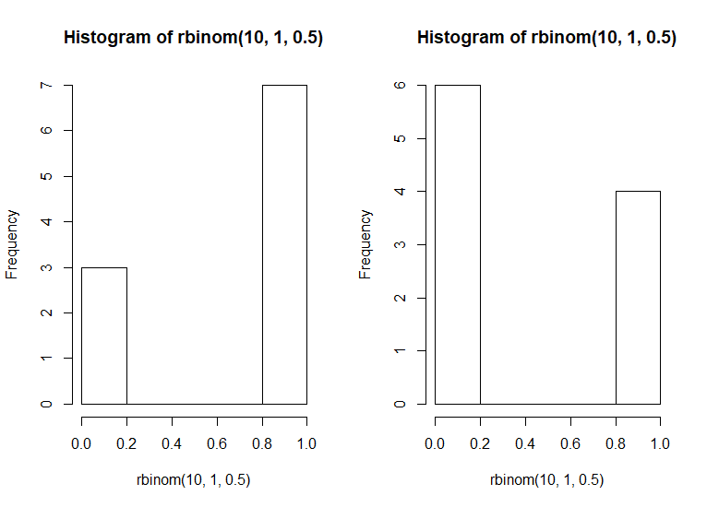
What happens when we flip 10 coins?
We use the Bernoulli/Binomial Distribution to determine the number of times it landed on each in 10 trials
Then we do it again and see that we got different results from another 10 trials
hist(rbinom(10, 1, 0.5))

Slide 5
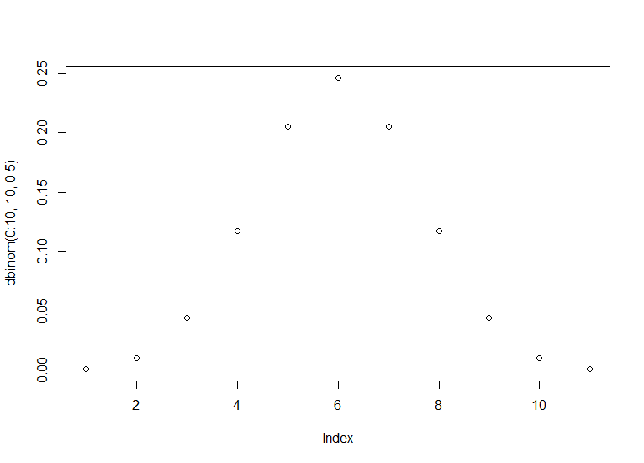
The likelihood of observing different outcomes varies depending on the number of trials and probability of success

Slide 6
Probability Distributions
Functions that describe the likelihood of observing a set of outcomes from a random variable
They do this by using parameters like the mean and standard deviation to calculate the likelihood of you observing a value
Usually these parameters are related to moments of a distribution like the mean or the variance
Despite these general similarities among probability distributions, the parameters that dictate the form of probability distributions vary considerably depending on the distribution

Slide 7
Why do we have different probability distributions?
Supports different ranges of values from variables
Just a few examples:
All real numbers (-infinity, +infinity)
All positive numbers (0, +infinity)
Categorial data (yes/no)
Count data (0, 1, 2, … N)
They apply to different real world processes
A few more examples:
Linear and continuous (e.g., Gaussian distribution)
Exponential and continuous (e.g., Log-normal distribution)
Yes/no trials (e.g., Bernoulli distribution)
Counts (e.g., Poisson distribution)
Rates of occurrence (e.g., Gamma distribution)

Slide 8
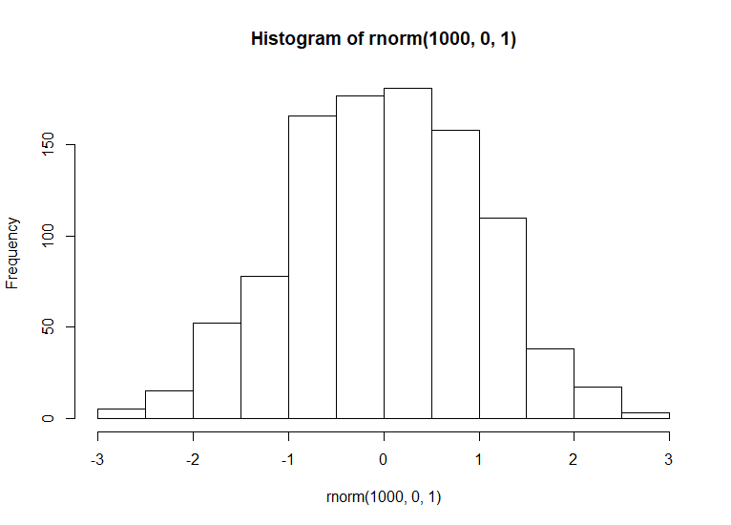
Normal
Parameters:
μ (mean)
σ (standard deviation)

Slide 9
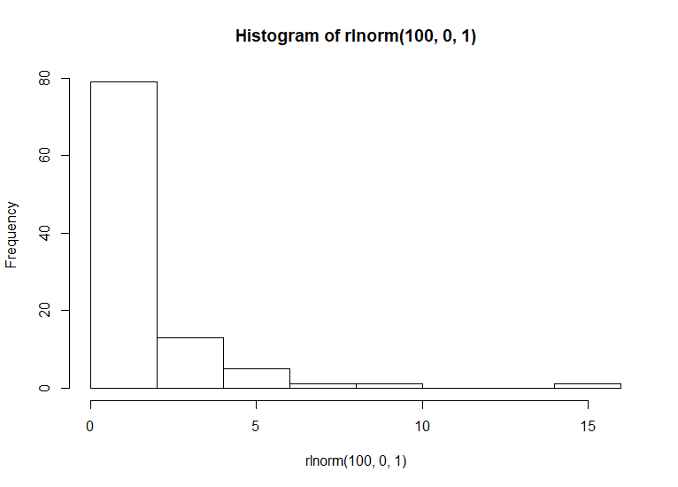
Log-Normal
Parameters:
μ (log(mean))
σ (log(standard deviation)

Slide 10
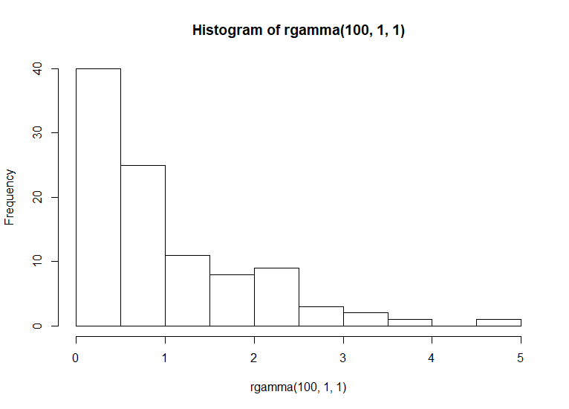
Gamma
Parameters:
α (shape)
β (rate)

Slide 11
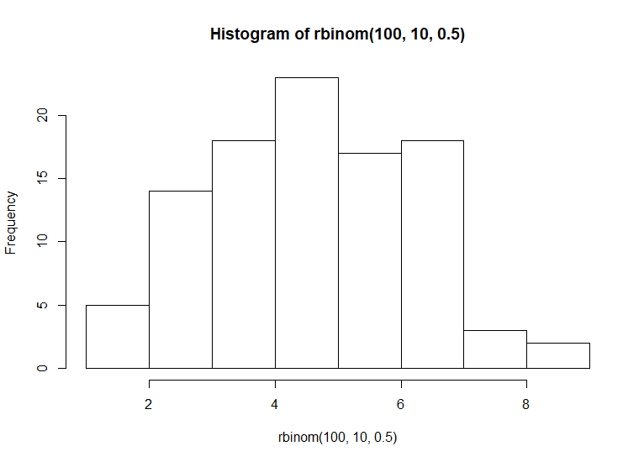
Binomial

Slide 12
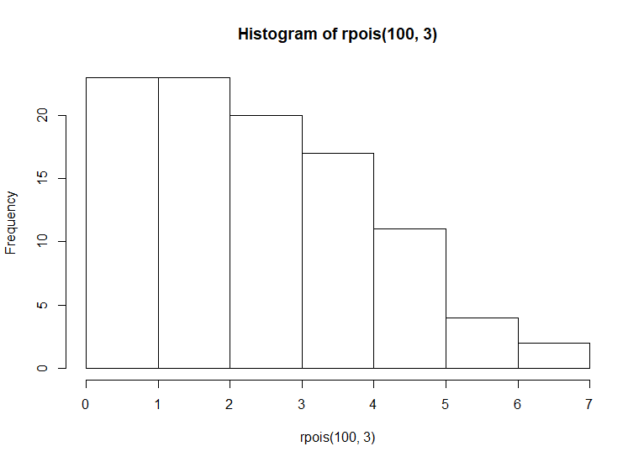
Poisson

Slide 13
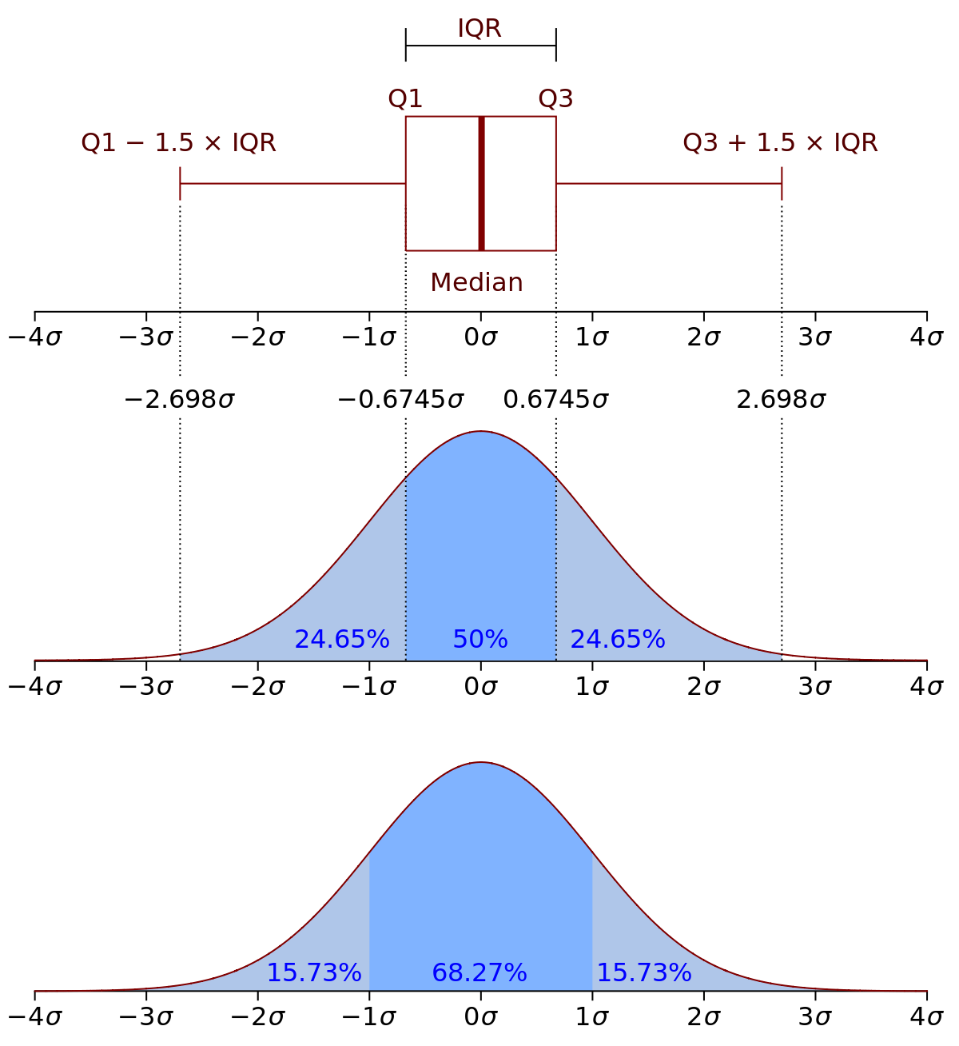
Probability Density/Mass Functions
The parameters are used with the PDF/PMF from the probability distribution to calculate the probability of observing certain values
Thus as the parameters of the distribution change, the probability of observing a given value changes with it

Slide 14
What kinds of probability distributions do you use most when modeling count data?
The count data distributions:
Poisson
Zero-inflated Poisson
Negative Binomial
Zero-inflated Negative Binomial
Non-count data distributions
Gaussian
Binomial

Slide 15

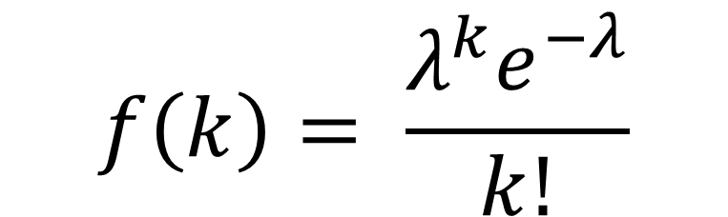
The Poisson distribution
The classic distribution for handling count data
The main parameter is intensity (λ)
Key limitation: the mean is equal to variance (so λ accounts for both)
We calculate the probability of a count of k as:
$$f\left(k\right)= \frac{λ^{k}e^{−λ}}{k!}$$
PMF

Slide 16
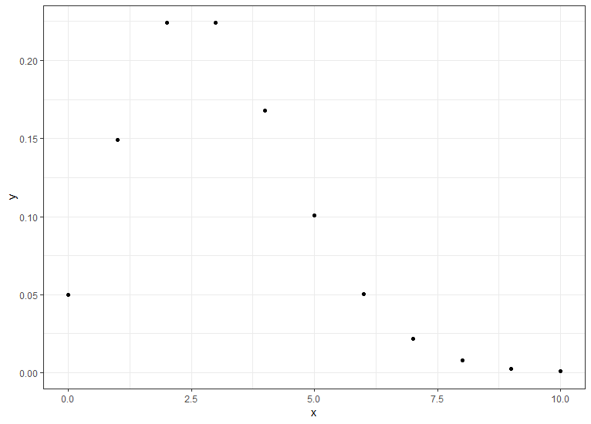
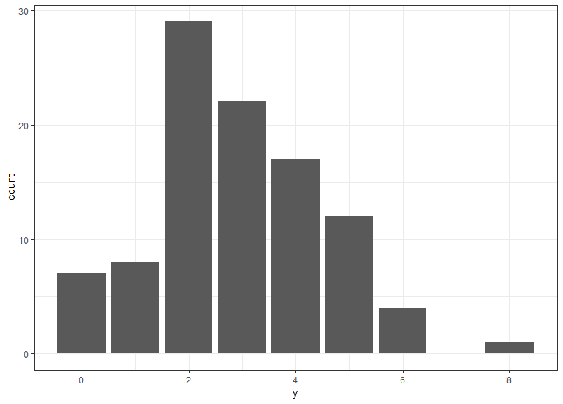
The Poisson distribution
PMF
Random Draw from the PMF

Slide 17
The Poisson distribution
Limitations of the Poisson
The mean-variance relationship is 1 to 1, so it’s very constrained
In ecology we often find count data that are overdispersed (i.e., have more variance than the mean)
This is a product of sparse, auto-correlated, and clustered distributions of animals (among other possibilities)
When this is the case, the Poisson will underpredict zeroes and high counts, making our models not as useful
Not all birds present at the survey are detected
That means that the count data we collect are biased (specifically, biased low)
Another process is occurring that that augments our probability of counting a bird

Slide 18
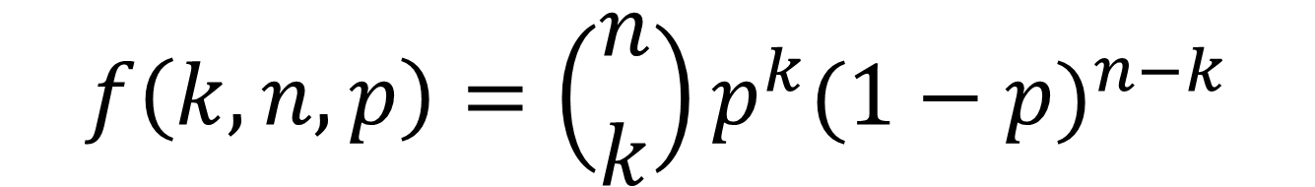
Binomial Distribution
Good for multiple trials of yes/no data
Two parameters:
n = the number of trials
p = the probability of success
We calculate the probability of getting k successes as:
$$f\left(k, n, p\right)=\left({n \atop k}\right)p^{k}{(1−p)}^{n−k}$$

Slide 19
Binomial Distribution
Three main reasons that we care about the binomial distribution for count data:
The Poisson distribution is actually a special case of the binomial
You might have noticed that the binomial distribution can create count data from earlier, the Poisson occurs when n is very high and p is very low
It can be used to augment the Poisson distribution to allow it to estimate more zeroes than it would usually
It can be used to model bias in the count data
A major source of bias is the probability that you detected a bird or not
Since detection probability is a binomial outcome (you either did or you didn’t), it can be modeled with a binomial distribution

Slide 20
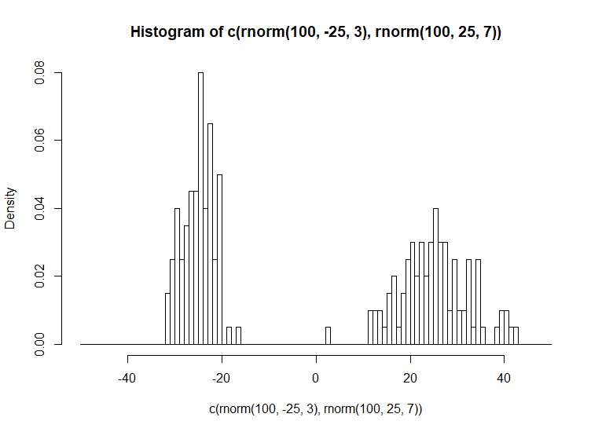
Brief Aside: Mixing probability distributions
Here we have data that occur from two different Gaussian probability distributions

Slide 21
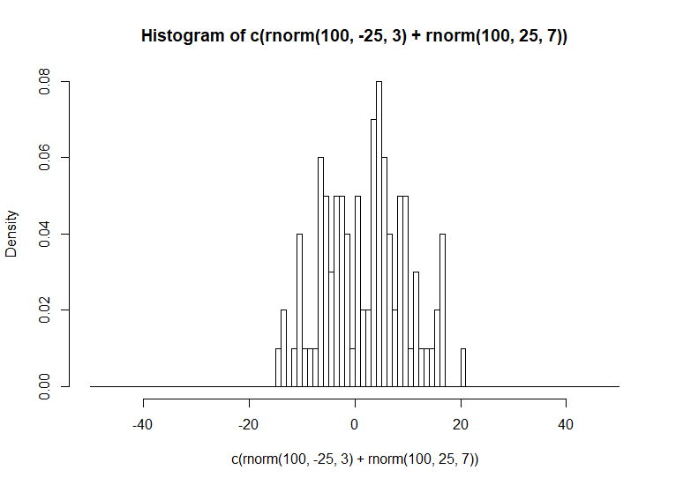
Brief Aside: Mixing probability distributions
They can be mixed together to create a new distribution with their combined properties. This is the equivalent of only being able to observe the sum of two variables.

Slide 22
So what happens if we mix the binomial and Poisson distributions?
X
Poisson
Binomial

Slide 23
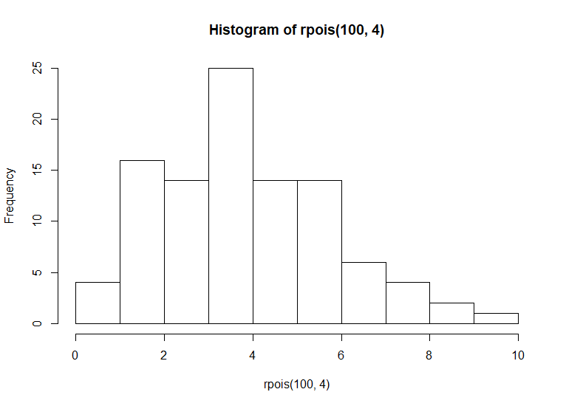
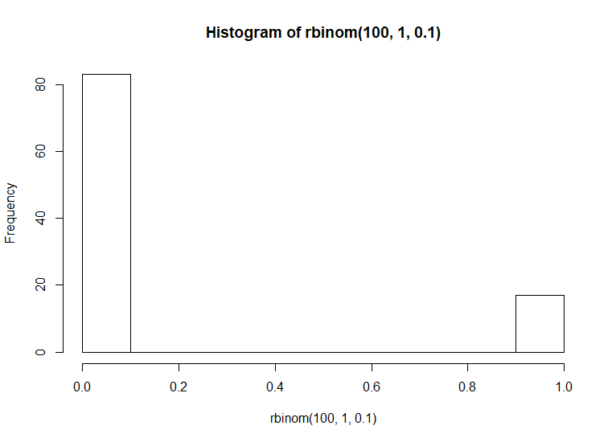
Brief Aside: Mixing probability distributions
If your Poisson distribution doesn’t have enough zeroes to match your data, then you can add them by combining it with a binomial distribution
X

Slide 24
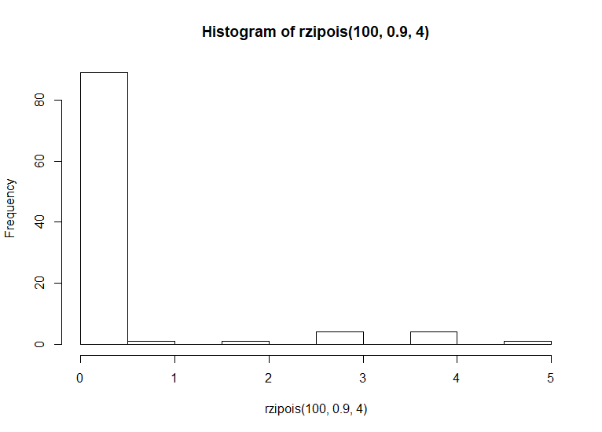
Brief Aside: Mixing probability distributions
Now you can make a new distribution that describes your data better

Slide 25
Final Note: Combining probability distributions
Today we’ll be talking about combining the Poisson distribution and the binomial distribution in multiple contexts
A Poisson-Binomial Mixture: This comes up when we are discussing hierarchical count models like N-mixture models
EX: When you have count data where you don’t detect all the animals so your counts are mixture of a count process and a binomial process
A Zero-inflated Model: This comes up when we are talking about count data that have already been corrected for detection effects and still are overdispersed.

Slide 26
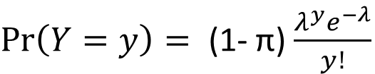


Zero-inflated Poisson Distribution
Similar to mixing probability distributions
Binomial distribution is mixed with a Poisson distribution to inflate the number of zeroes in the sample
Essentially we create an additional way to observe zeroes in the data
$$\operatorname{Pr}\left(Y=0\right)= \text{π}\text{ + (1− }\text{π}\text{)}e^{−λ}$$
$\operatorname{Pr}\left(Y=y\right)= \text{(1− }\text{π}\text{)}$ $\frac{λ^{y}e^{−λ}}{y!}$
$$y=1, 2, 3 …$$

Slide 27
Zero-inflated Poisson Distribution

Slide 28
Negative Binomial Distribution
A distribution for count data with two parameters
So another way for us to account for overdispersion that doesn’t involve just stapling a binomial distribution to this
Multiple parameterizations
As ecologists we like the one that allows us to estimate the mean and variance (rather than the fail rate)
Note that this is actually another mixture between a Poisson and gamma distribution
We won’t get into the details of the PMF today
Look it up if you’re interested

Slide 29
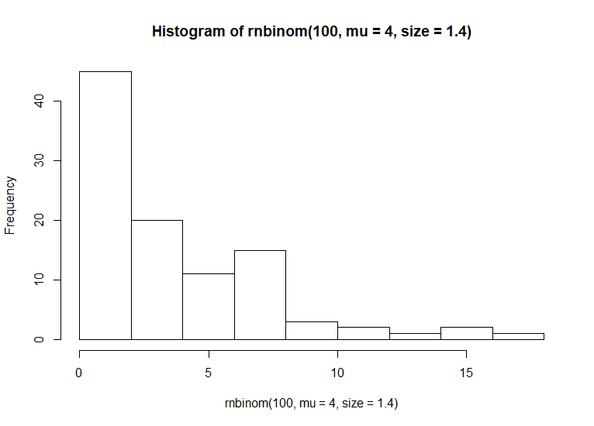
Negative Binomial Distribution

Slide 30
Zero-inflated Negative Binomial Distribution
Essentially the same concept as a ZIP
We won’t get into the PMF (again) but the concept is similar to a ZIP
We augment the probability of getting a zero with a binomial draw
This is used when you have more zeroes in your dataset than you thought possible in nature
i.e., seabird data

Slide 31
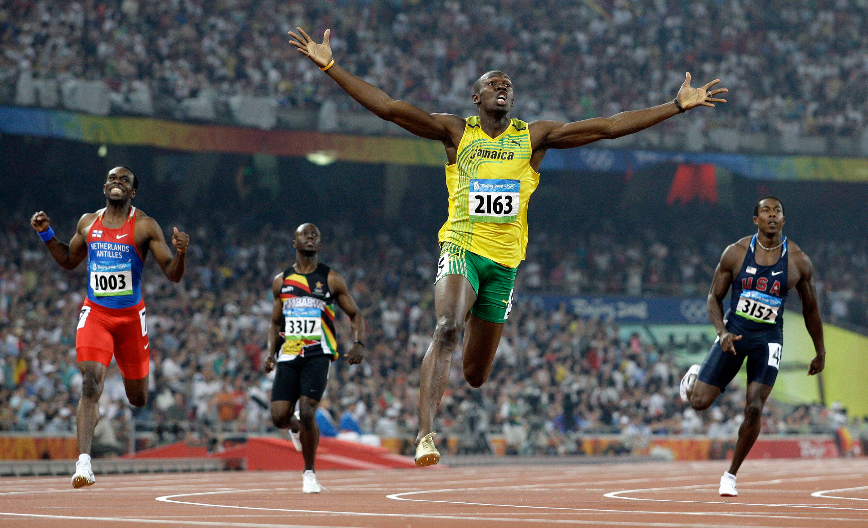

Slide 32
How do we know what distribution to use for count data?
Theoretical:
Think about the process that you are modeling
Do you expect there to be ‘structural zeroes’ or places that you surveyed that have a very small chance that your species would be detected
Empirical:
Look at your data!
Plot Poisson distributions with the same mean as your data and see if they look remotely similar
If they don’t, then try a ZIP, NB, or ZINB and see if that looks any better

Slide 33
Summary
Count responses are random variables that can have uncertainty described in many ways
Probability distributions are our way of calculating the likelihood of observing the data given the parameters
The Poisson distribution is a simple and effective tool for describing count data but it has limitations
By mixing the binomial distribution with count distributions we create a more flexible model that accounts for overdispersion that we often see with bird data
To determine what works best for your data set, consider the process that goes in to generating your data and what the final product actually looks like

Slide 34

Questions and Discussion

